Slide 1
A Computational Analysis of the 2D Ising Model
Patrick Blackstone and Holly Rudel

Slide 2
The Ising Model
Mathematical model to describe spontaneous magnetization of ferromagnetic materials
2D Computational Model

Slide 3
Conceptually
Start with a matrix, values only +/-1 to represent spin up or spin down
Go through the matrix N times implementing the Metropolis algorithm
Repeat this in multiple sweeps
Analyze long term behavior

Slide 4
Initialize
Created a structure Cake
  Constructor
    Arguments: m and T
  Magstats, engstats vectors
    Collect statistics for energy and magnetization when doing sweeps
  State matrix
    Set all values +1

Slide 5
Our Methods
printstate
  Test for when matrix =1, and when initialized to random numbers
flip
  Set value in position of matrix equal to its negative
decide
  A boolean that takes a row, column and a random
  Establishes periodic boundary conditions
  Calculates dE: same as -2*E
  Metropolis algorithm; Boltzmann factor
Notes:
Decide: if true Boltzmann > random, then flip (energy small enough)

Slide 6
Our Methods cont.
energy
  Calculates and energy of the state based on spin pair interactions
  Avoid double counting
  Boundary conditions
  Returns energy per spin of the state, stored in engstats vector
magnet
  Sums values of spins throughout matrix
  Returns magnetization per spin of state, stored in magstats vector
Notes:
Double counting: take only right and down neighbor. stats method?

Slide 7
Sweeping
Inner loop: one sweep
  Go through matrix N times using random entry in matrix
  Implement decide method, flip if necessary
Outer loop: many sweeps
  Repeat this process many times depending how long values took to converge.
Calculate energy and magnetization using methods
  Once we know how many sweeps it takes to converge, collect energy and magnetization to calculate averages
Notes:
Decide: if true Boltzmann > random, then flip (energy small enough)

Slide 8
Main Code
Create an object of type Cake
  User inputs dimension of matrix
  Hard code temperature
  Use sweep method
  Print stats and evaluate graphs of magnetization and energy as a function of sweeps
    Found values converging around 500 sweeps at T_{c}
    Started collected values for averages at 600 sweeps, ran code until 750

Slide 9
Various Temperatures
Interested in the behavior of the model at various temperatures. Chose range to be 0.01-5. Used ‘for’ loop
Created a second cake object, swept through 750 times, collecting stats after 600 sweeps
  Plotted our magnetization and energy averages against temperature
  Found around critical region to be unresolved: coordinate transformation

Slide 10
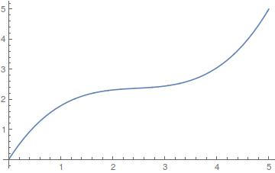
temp = s * (0.145*s*s – 1.0667*s + 2.7085)

Slide 11
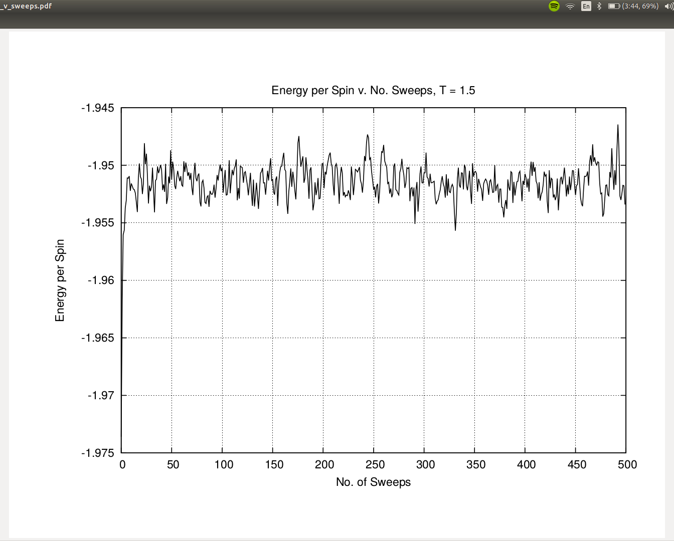
Results: T < Tc

Slide 12
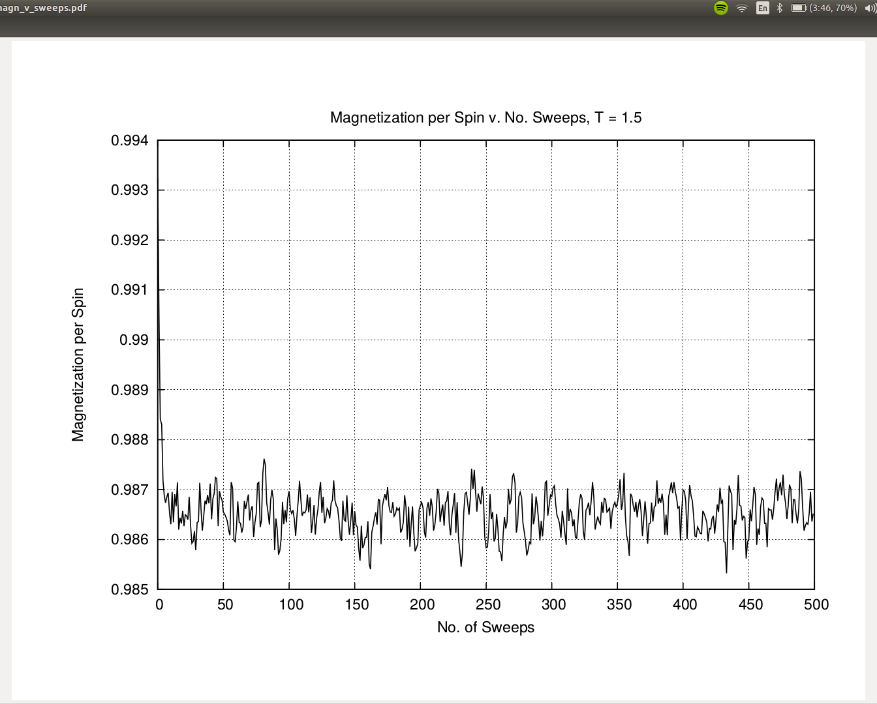
Results: T < Tc

Slide 13
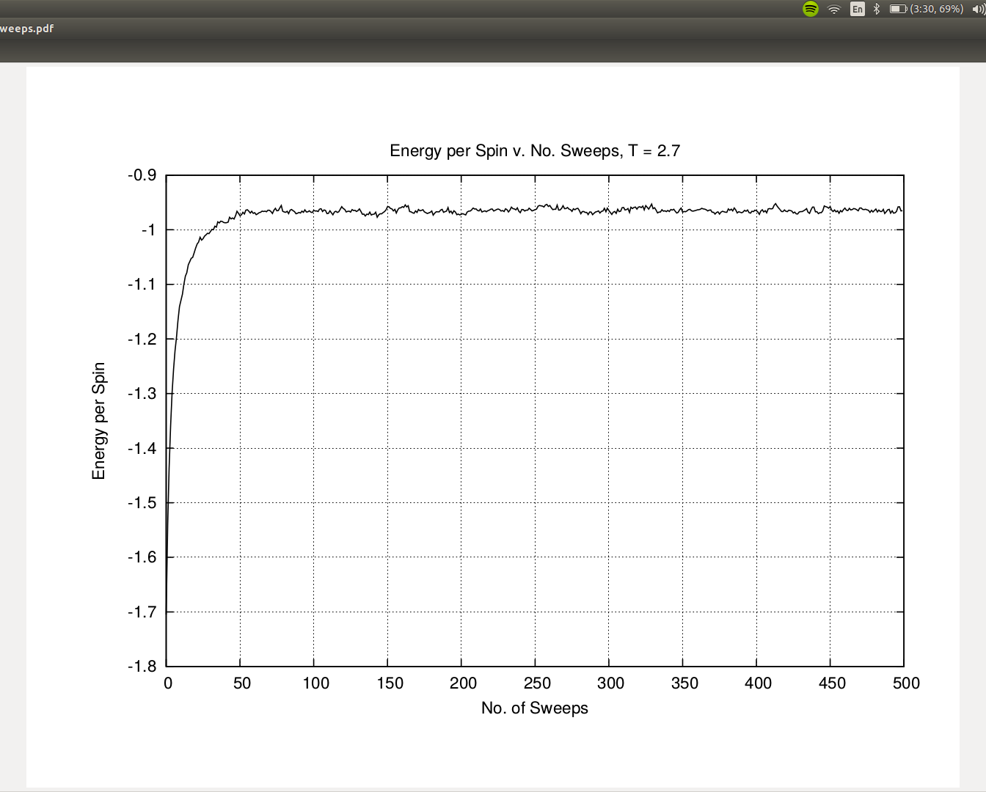
Results: T > Tc

Slide 14
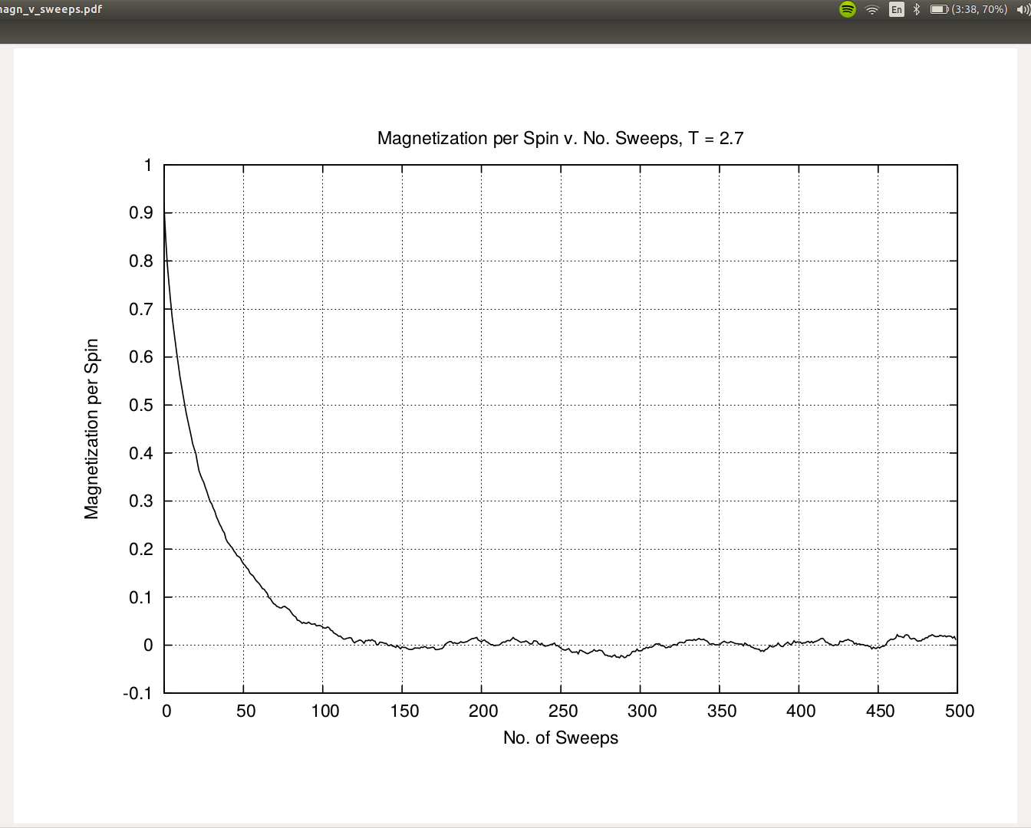
Results: T > Tc

Slide 15
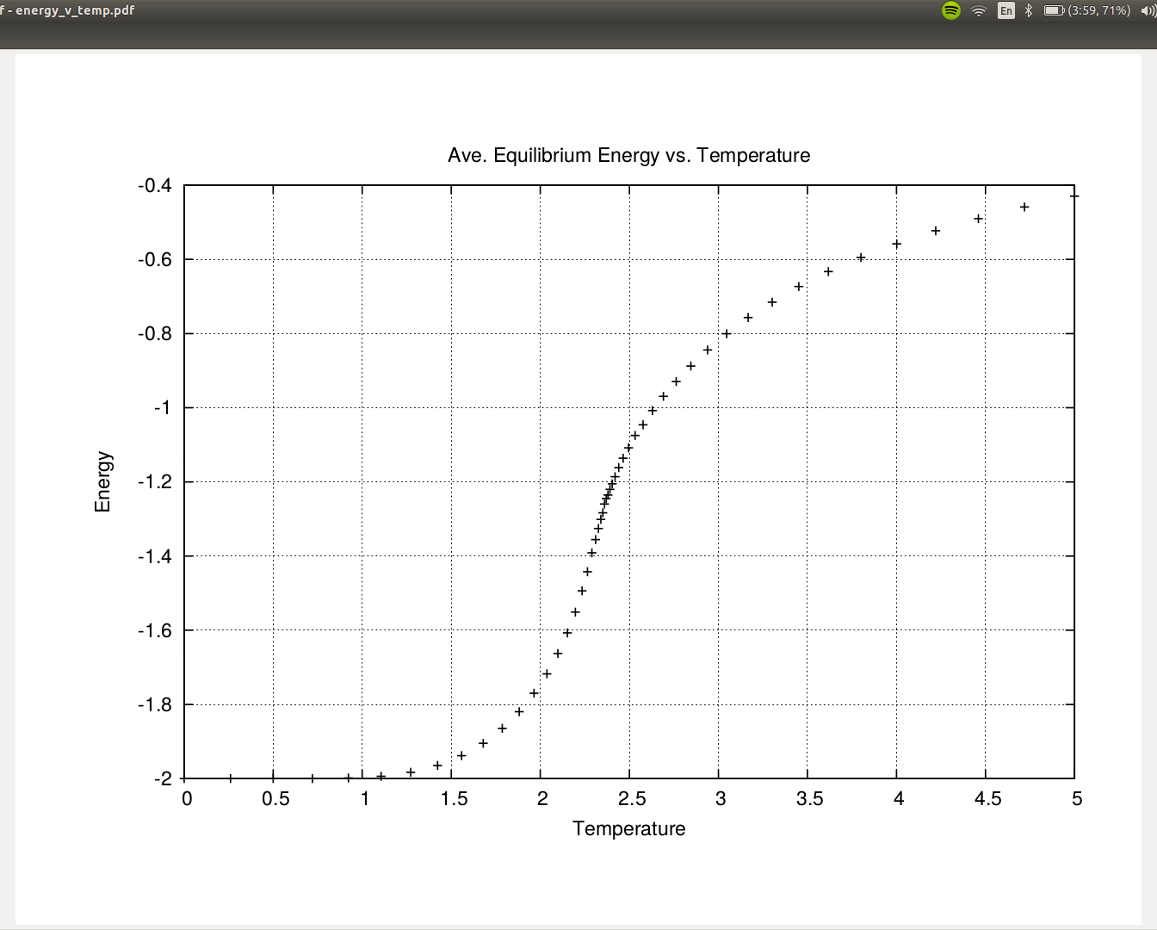
Results: <Energy> vs. Temp

Slide 16
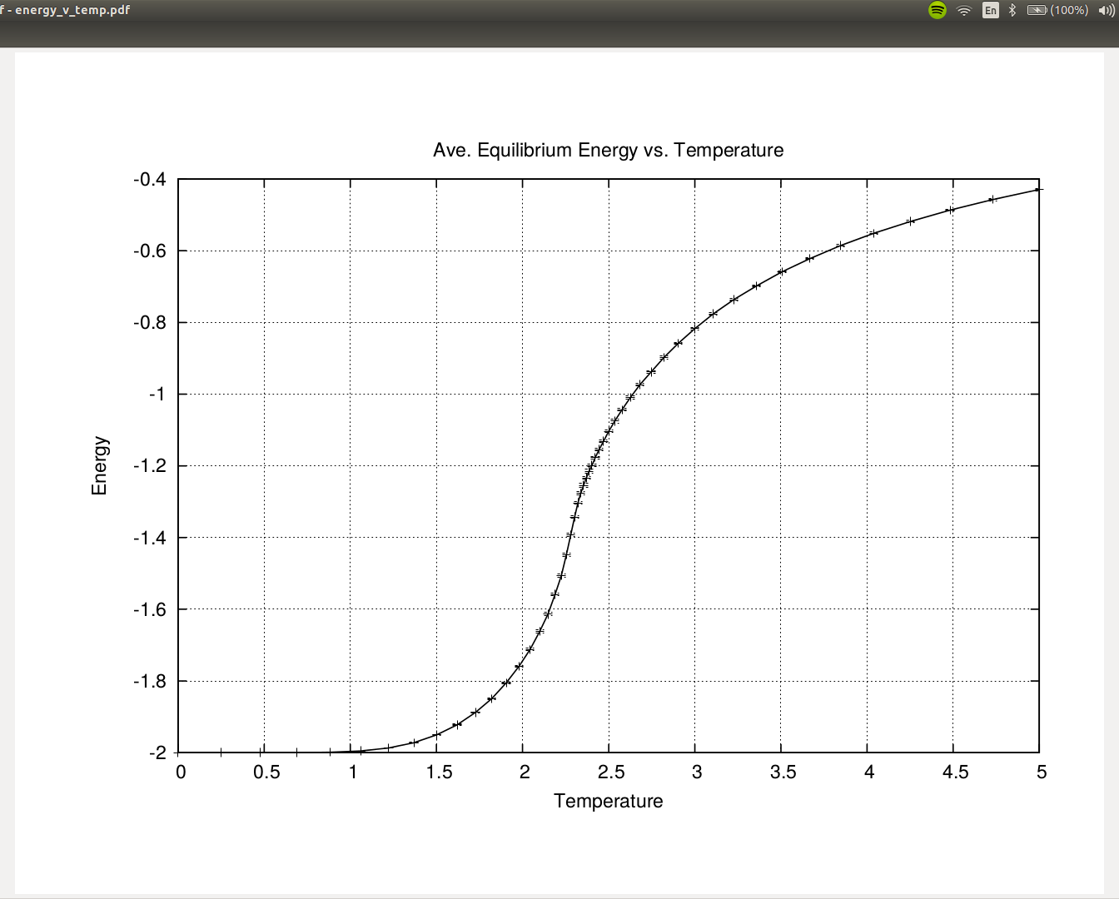
Results: <Energy> vs. Temp

Slide 17
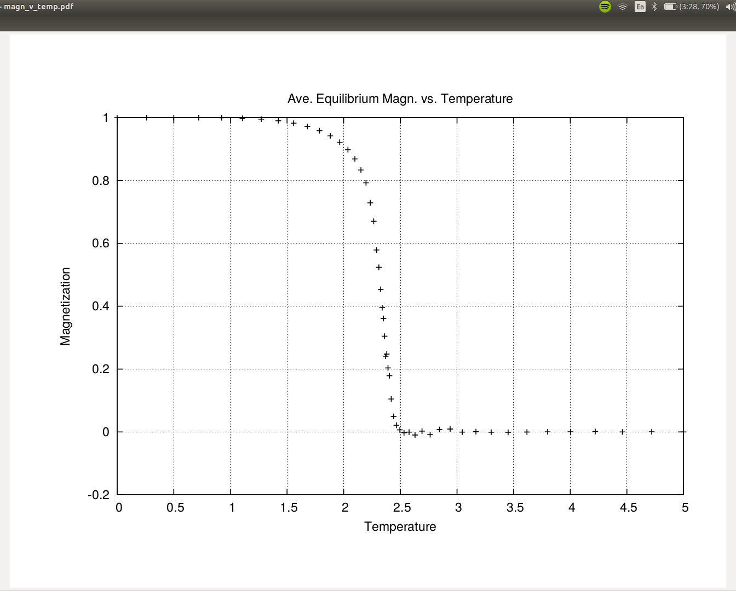
Results: <Magn.> vs. Temp

Slide 18
Results: <Magn.> vs. Temp

Slide 19
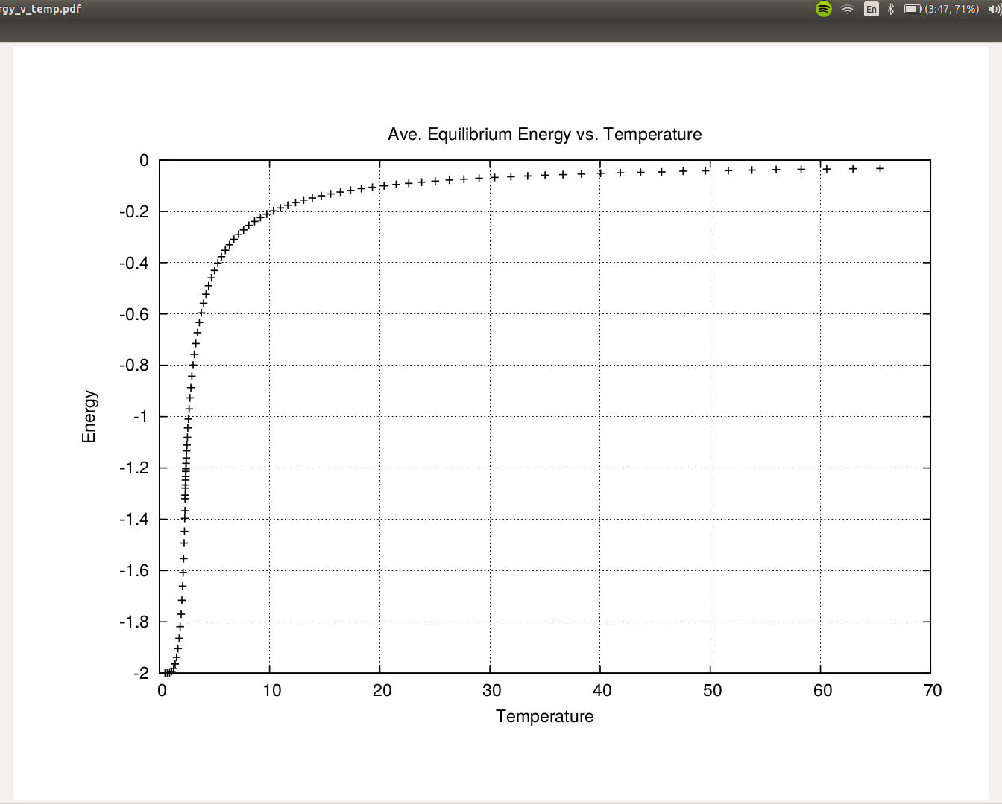
Results: T >>Tc

Slide 20
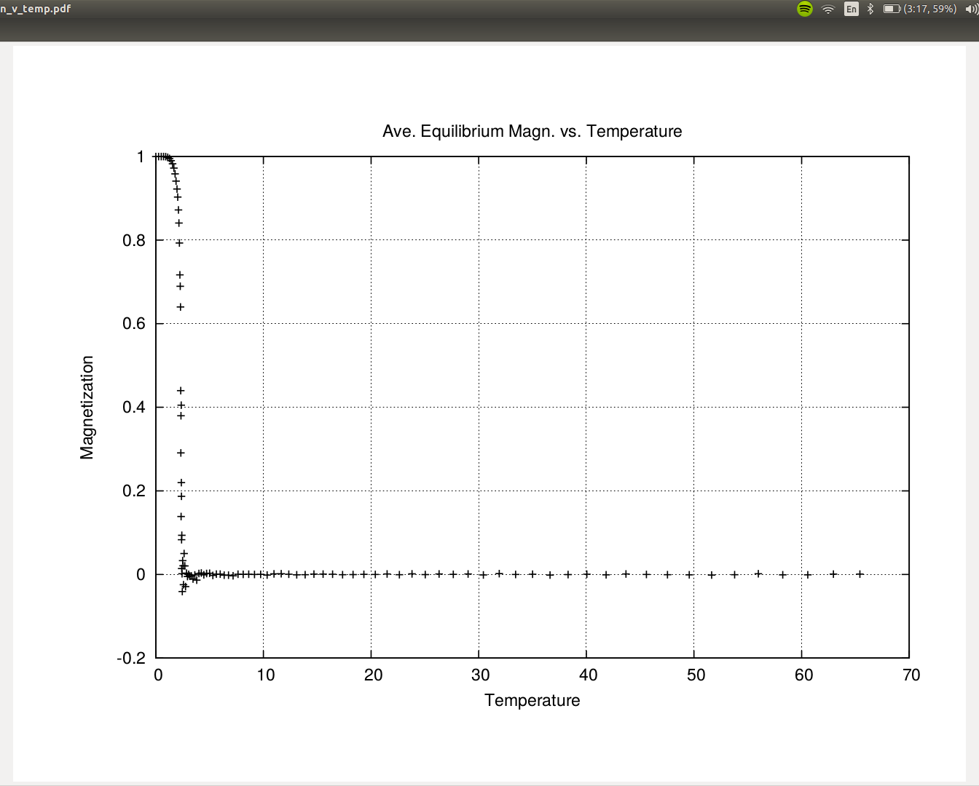
Results: T >> Tc

Slide 21
Issues and Concerns
Pointers (stats and state)
masterSeed

